Slide 1
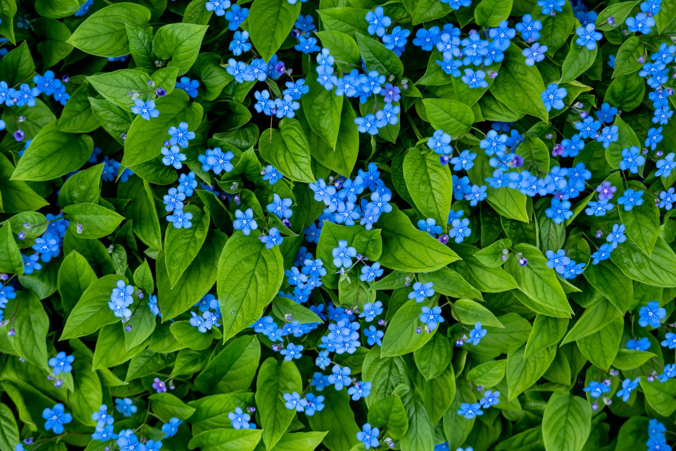


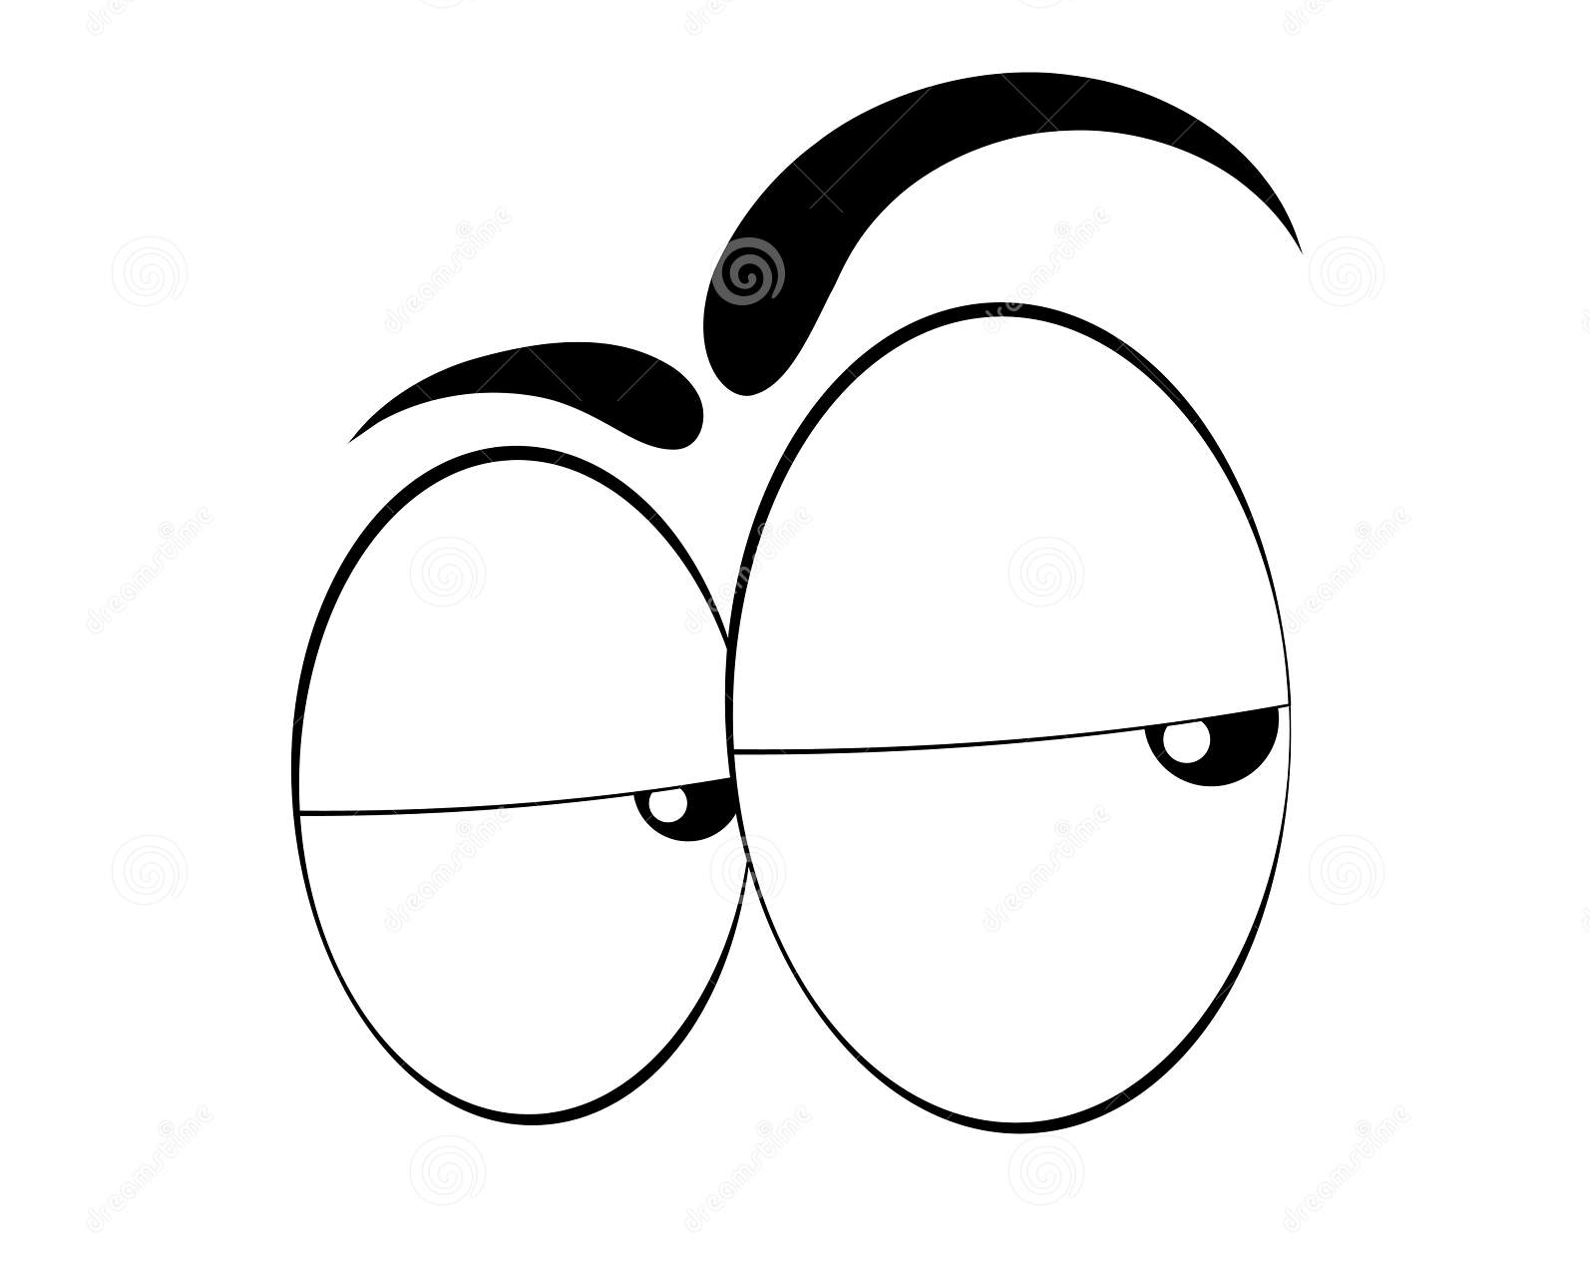
Plant Monitor
Codrina-Victoria IGNAT
Master AAIE, anul I

Slide 2
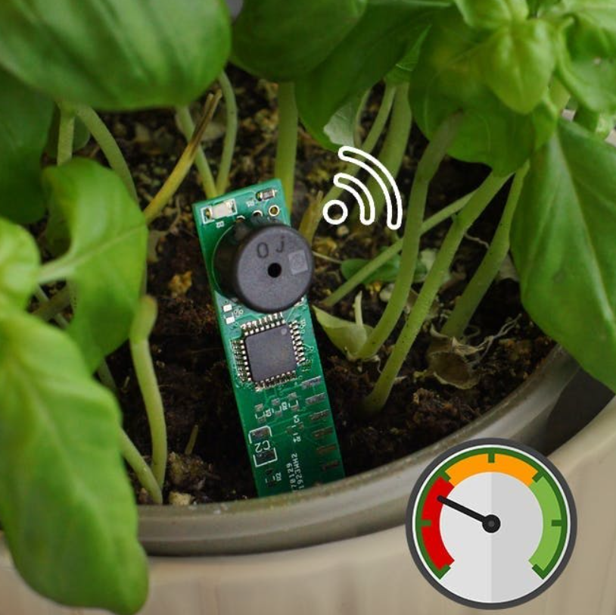
Cuprins
Obiectivul proiectului
Schema bloc
Schema de conexiuni
Funcționare
Simulări
Codul
Bill of materials
Îmbunătățiri viitoare
Bibliografie

Slide 3

Obiectivul proiectului
Monitorizarea temperaturii ambientale din apropierea unei plante
Monitorizarea umidității solului acelei plante
Starea plantei este evidențiată printr-un LED și un mesaj afișat
Umiditatea solului prea mică sau prea mare și temperatura prea mică sau prea mare sunt semnalate acustic printr-un buzzer
Repere:
Temperatura adecvată: maxim 35°C, minim 10 °C
Umiditatea solului adecvată: între 20 și 80%.

Slide 4
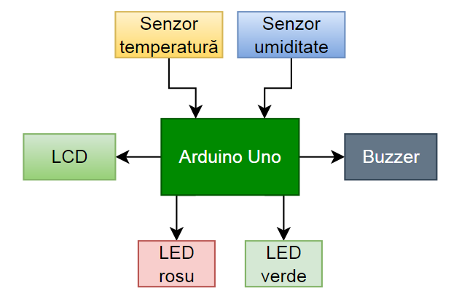
Schema bloc

Slide 5
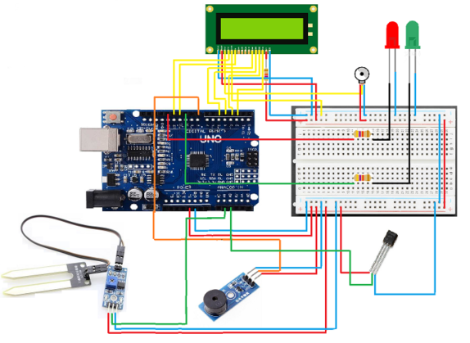
Schema de conexiuni

Slide 6
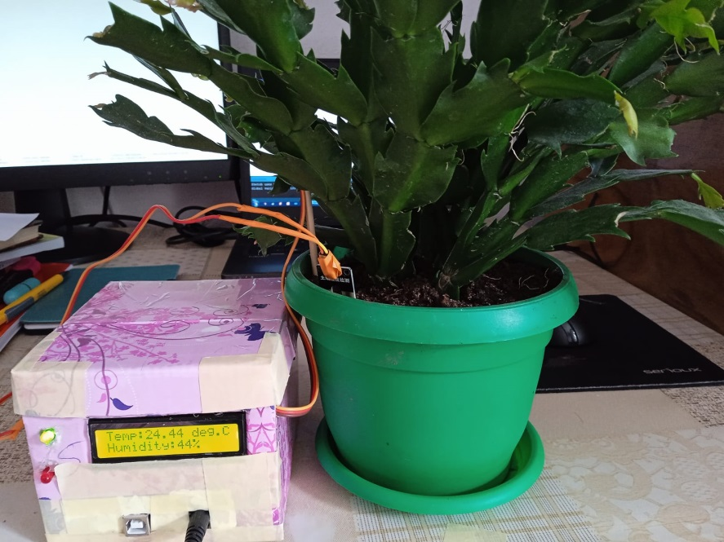
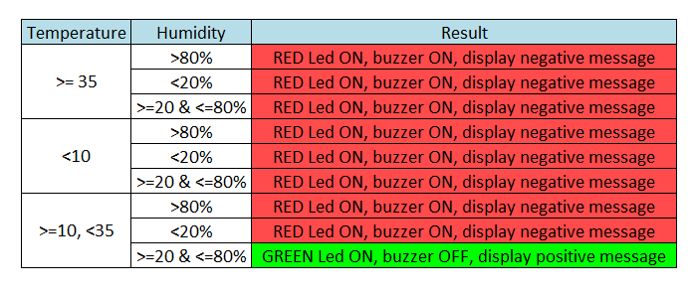
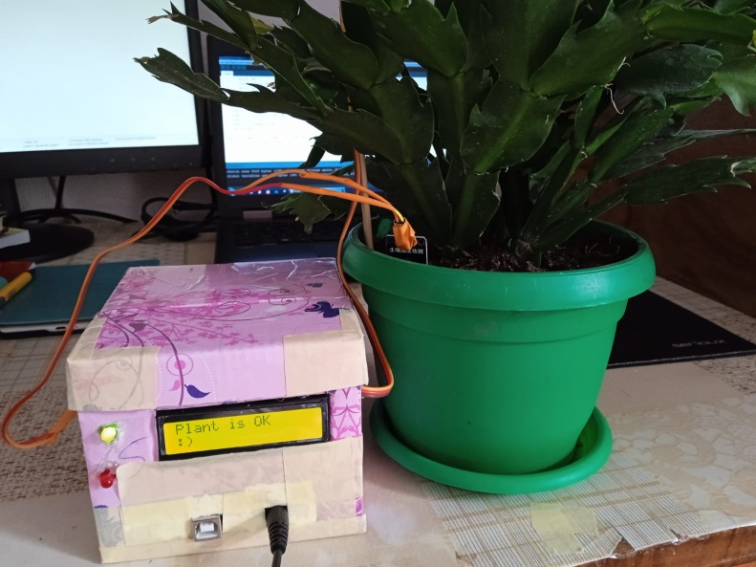
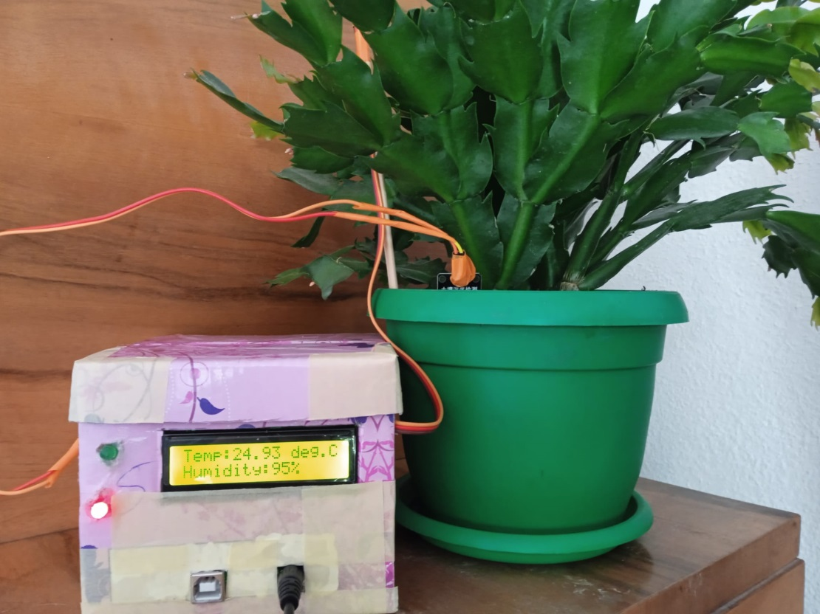
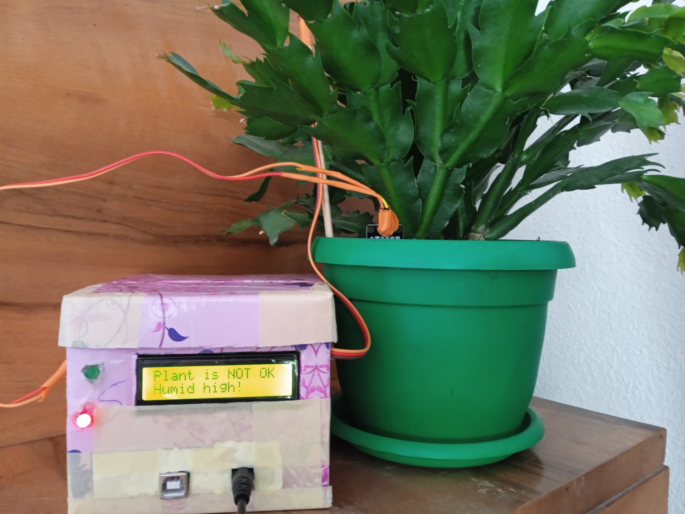
Functionare

Slide 7
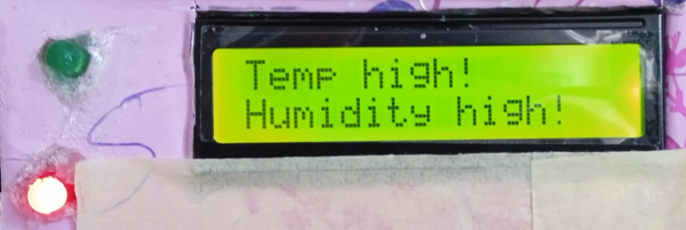
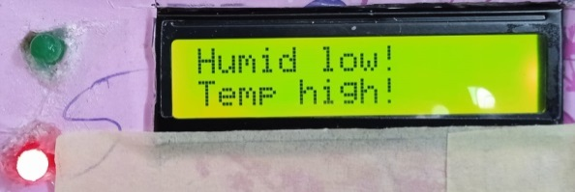
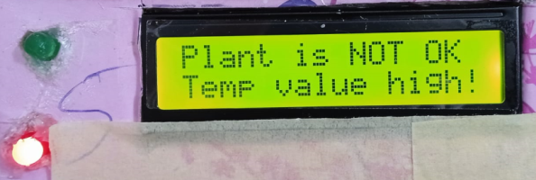
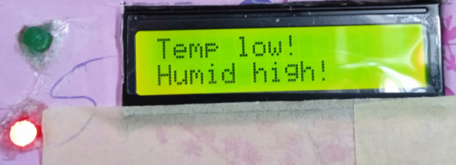
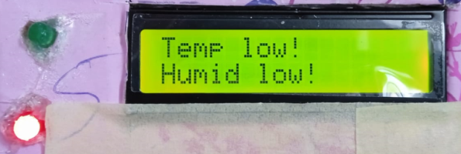
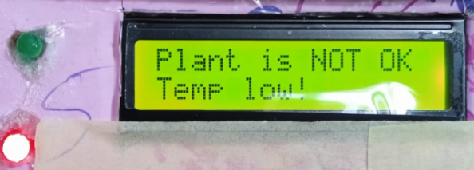
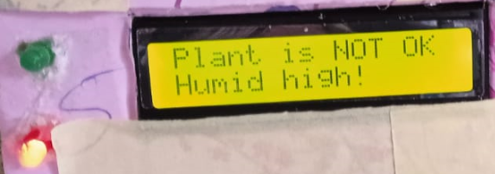
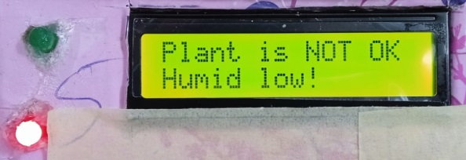
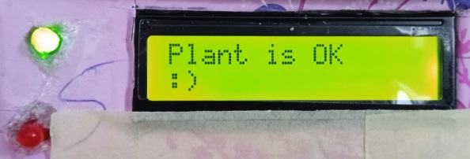
Simulări

Slide 8
Codul
#include <LiquidCrystal.h>
#define redLED 13
#define greenLED 10
const int rs = 12, en = 11, d4 = 5, d5 = 4, d6 = 3, d7 = 2;
LiquidCrystal lcd(rs, en, d4, d5, d6, d7);
int buzzer = 8;
int hygrometer = A1;
int HumidValue;
int pinTemp = A2;
void setup()
{
pinMode (buzzer, OUTPUT);
pinMode (redLED, OUTPUT);
pinMode (greenLED, OUTPUT);
pinMode (pinTemp, INPUT);
pinMode (hygrometer, INPUT);
lcd.begin(16,2);
}
void loop()
{
HumidValue = analogRead(hygrometer);
HumidValue = constrain(HumidValue, 400, 1023);
HumidValue = map(HumidValue, 400, 1023, 100, 0);
delay(200);
float temp;
int counter = 25;
int avg = 0;
for (int i = 0; i< counter; i++)
{
avg += analogRead(pinTemp);
}
avg = avg / counter;
temp = avg * (5000 / 1024.0); //converting from reading into voltage
temp = temp / 10; //converting the voltage into the temperature in degree Celsius

Slide 9
lcd.clear();
lcd.setCursor(0,0);
lcd.print("Temp:");
lcd.print(temp);
lcd.print(" deg.");
lcd.print("C");
lcd.setCursor(0,1);
lcd.print("Humidity:");
lcd.print(HumidValue);
lcd.print("%");
delay(5000);
if (temp >= 35 & HumidValue > 80)
{
digitalWrite (redLED, HIGH);
digitalWrite (buzzer, HIGH);
int i;
for (i = 0; i<200; i++)
{
digitalWrite (buzzer, HIGH) ;
delay (2) ;
digitalWrite (buzzer, LOW) ;
delay (2) ;
}
digitalWrite (greenLED, LOW);
lcd.clear();
lcd.begin(16,2);
lcd.setCursor(0,0);
lcd.print("Temp high!");
lcd.setCursor(0,1);
lcd.print("Humidity high!");
delay(2000);
}
else if (temp >= 35 & HumidValue>=20 & HumidValue <=80)
{
digitalWrite (redLED, HIGH);
digitalWrite (buzzer, HIGH);
int i;
for (i = 0; i <200; i++)
{
digitalWrite (buzzer, HIGH) ;
delay (2) ;
digitalWrite (buzzer, LOW) ;
delay (2) ;
}
digitalWrite (greenLED, LOW);
lcd.clear();
lcd.begin(16,2);
lcd.setCursor(0,0);
lcd.print("Plant is NOT OK");
lcd.setCursor(0,1);
lcd.print("Temp value high!");
delay(2000);
}
else if (temp >= 35 & HumidValue < 20){
digitalWrite (redLED, HIGH);
digitalWrite (buzzer, HIGH);
int i;
for (i = 0; i <200; i++)
{
digitalWrite (buzzer, HIGH) ;
delay (2) ;
digitalWrite (buzzer, LOW) ;
delay (2) ;
}
digitalWrite (greenLED, LOW);
lcd.clear();
lcd.begin(16,2);
lcd.setCursor(0,0);
lcd.print("Humid low!");
lcd.setCursor(0,1);
lcd.print("Temp high!");
delay(2000);
}
else if (temp <10 & HumidValue > 80){
digitalWrite (redLED, HIGH);
digitalWrite (buzzer, HIGH);
int i;
for (i = 0; i <200; i++)
{
digitalWrite (buzzer, HIGH) ;
delay (2) ;
digitalWrite (buzzer, LOW) ;
delay (2) ;
}
digitalWrite (greenLED, LOW);
lcd.clear();
lcd.begin(16,2);
lcd.setCursor(0,0);
lcd.print("Temp low!");
lcd.setCursor(0,1);
lcd.print("Humid high!");
delay(2000);
}

Slide 10
else if (temp <10 & HumidValue < 20){
digitalWrite (redLED, HIGH);
digitalWrite (buzzer, HIGH);
int i;
for (i = 0; i <200; i++)
{
digitalWrite (buzzer, HIGH) ;
delay (2) ;
digitalWrite (buzzer, LOW) ;
delay (2) ;
}
digitalWrite (greenLED, LOW);
lcd.clear();
lcd.begin(16,2);
lcd.setCursor(0,0);
lcd.print("Temp low!");
lcd.setCursor(0,1);
lcd.print("Humid low!");
delay(2000);
}
else if (temp <10 & HumidValue <= 80 & HumidValue >= 20){
digitalWrite (redLED, HIGH);
digitalWrite (buzzer, HIGH);
int i;
for (i = 0; i <200; i++)
{
digitalWrite (buzzer, HIGH) ;
delay (2) ;
digitalWrite (buzzer, LOW) ;
delay (2) ;
}
digitalWrite (greenLED, LOW);
lcd.clear();
lcd.begin(16,2);
lcd.setCursor(0,0);
lcd.print("Plant is NOT OK");
lcd.setCursor(0,1);
lcd.print("Temp low!");
delay(2000);
}
else if (temp >= 10 & temp <35 & HumidValue > 80){
digitalWrite (redLED, HIGH);
digitalWrite (buzzer, HIGH);
int i;
for (i = 0; i <200; i++)
{
digitalWrite (buzzer, HIGH) ;
delay (2) ;
digitalWrite (buzzer, LOW) ;
delay (2) ;
}
digitalWrite (greenLED, LOW);
lcd.clear();
lcd.begin(16,2);
lcd.setCursor(0,0);
lcd.print("Plant is NOT OK");
lcd.setCursor(0,1);
lcd.print("Humid high!");
delay(2000);
}
else if (temp >= 10 & temp < 35 & HumidValue < 20){
digitalWrite (redLED, HIGH);
digitalWrite (buzzer, HIGH);
int i;
for (i = 0; i <200; i++)
{
digitalWrite (buzzer, HIGH) ;
delay (2) ;
digitalWrite (buzzer, LOW) ;
delay (2) ;
}
digitalWrite (greenLED, LOW);
lcd.clear();
lcd.begin(16,2);
lcd.setCursor(0,0);
lcd.print("Plant is NOT OK");
lcd.setCursor(0,1);
lcd.print("Humid low!");
delay(2000);
}
else
{
digitalWrite (redLED, LOW);
digitalWrite (buzzer, LOW);
digitalWrite (greenLED, HIGH);
lcd.clear();
lcd.begin(16,2);
lcd.setCursor(0,0);
lcd.print("Plant is OK");
lcd.setCursor(0,1);
lcd.print(":)");
delay(1000);
}
}

Slide 11
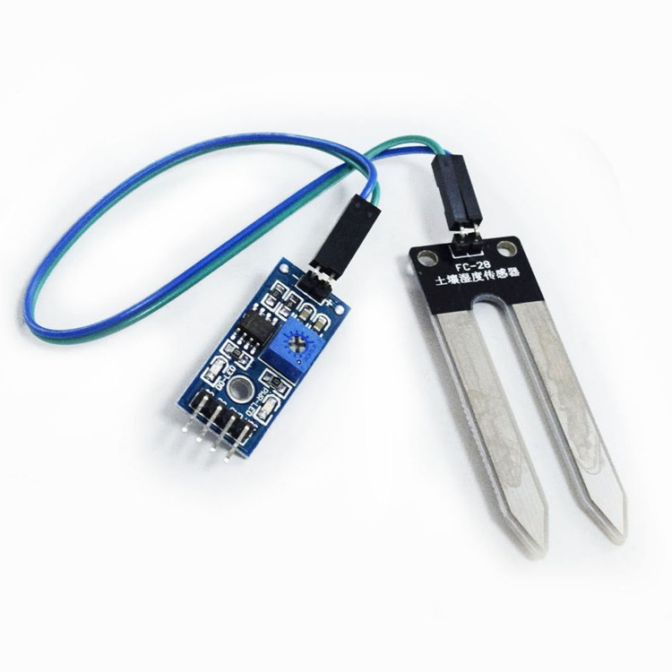
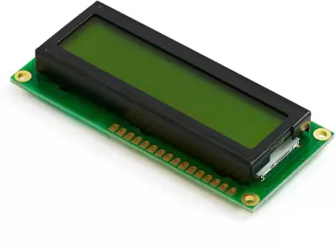

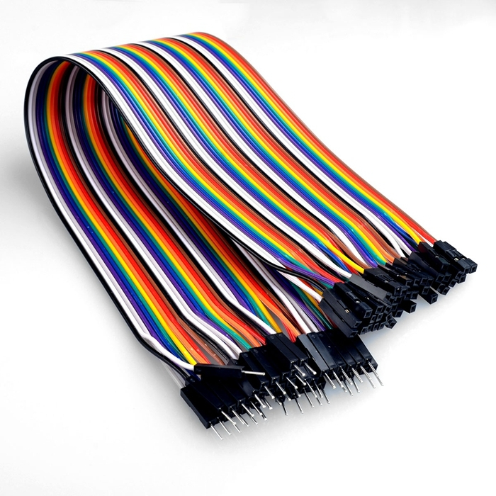
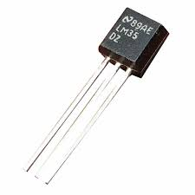
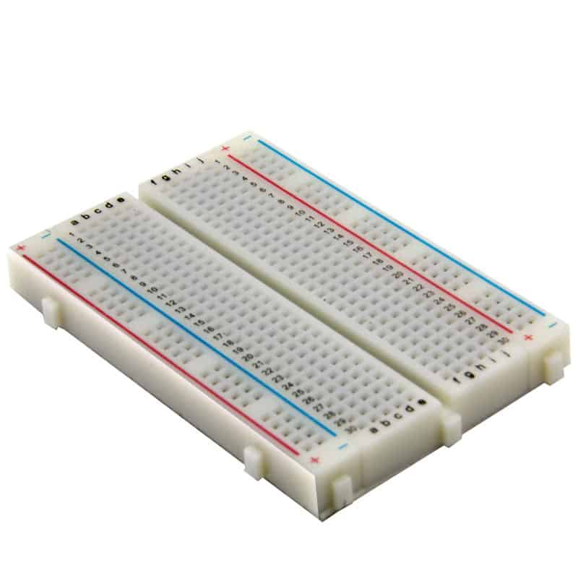
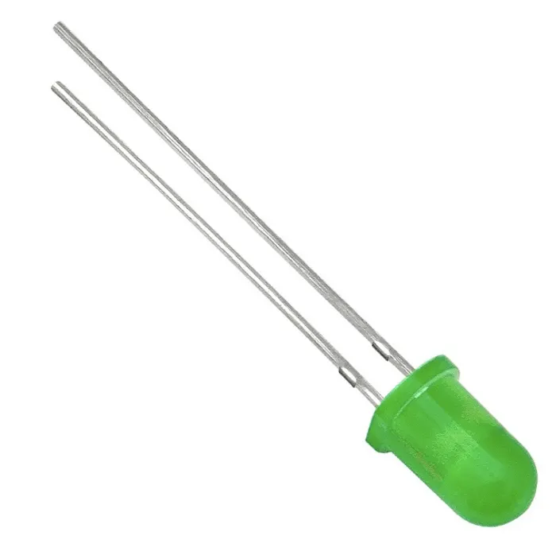
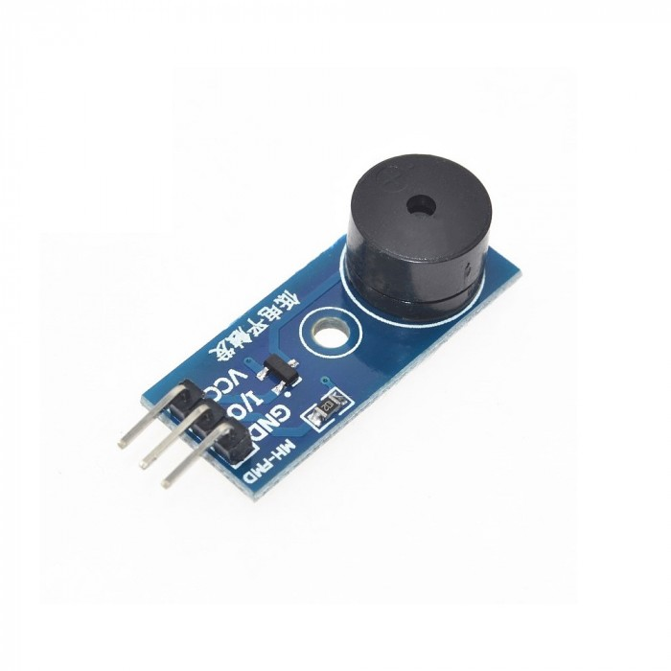
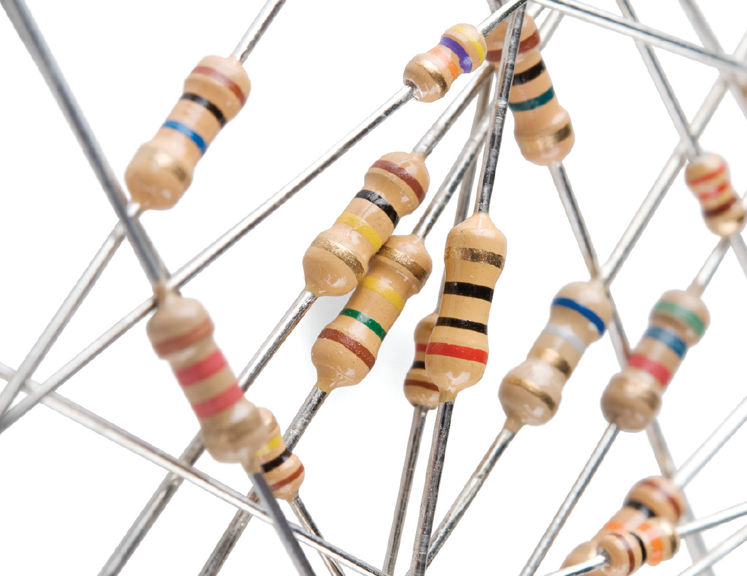
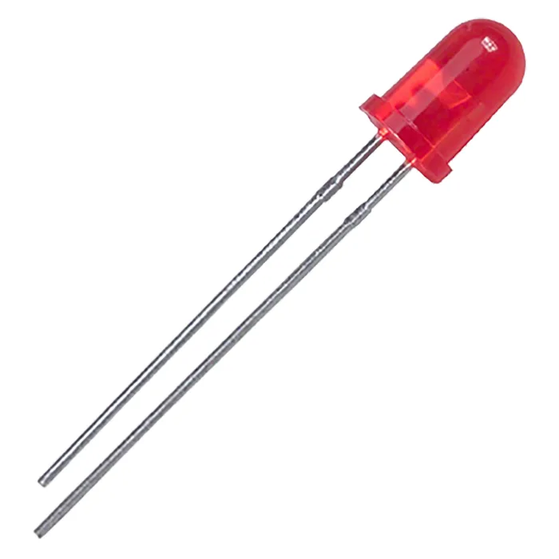
Bill of materials
Arduino Uno
Display LCD
Breadboard
LED-uri
LM35 senzor temperatură
Modul buzzer
Modul senzor de umiditate a solului
Rezistori
Fire

Slide 12

Îmbunătățiri viitoare
Aplicație mobilă / website de monitorizare a parametrilor
Opțiunea de a opri buzzer-ul de la distanță
Posibilitatea de a uda planta de la distanță
Umiditatea și temperatura optimă sunt specifice fiecărei plante în mod diferit. Dispozitivul ar putea avea butoane de reglaj pentru limitele acestora.

Slide 13

Bibliografie
https://espacepourlavie.ca/en/humidity-temperature-and-watering
https://www.ti.com/lit/ds/symlink/lm35.pdf
https://ardushop.ro/ro/home/44-modul-senzor-umiditate-sol-higrometru.html?search_query=NDGWBX_hygro&results=2
https://ardushop.ro/ro/home/89-modul-buzzer.html?search_query=DIHMTD_Buzz-pasiv&results=28
https://ardushop.ro/ro/electronica/36-lcd-1602.html?search_query=RFXVIY_LCD_1602blue&results=45
https://www.arduino.cc/en/Tutorial/BuiltInExamples/AnalogInput
https://www.electronicwings.com/arduino/lm35-interfacing-with-arduino-uno
https://create.arduino.cc/projecthub/MisterBotBreak/how-to-use-a-soil-moisture-sensor-ce769b
https://www.arduino.cc/reference/en/libraries/liquidcrystal/liquidcrystal/
https://www.arduino.cc/reference/en/language/functions/math/map/
https://lastminuteengineers.com/soil-moisture-sensor-arduino-tutorial/
https://www.makerguides.com/lm35-arduino-tutorial/

